Slide 1
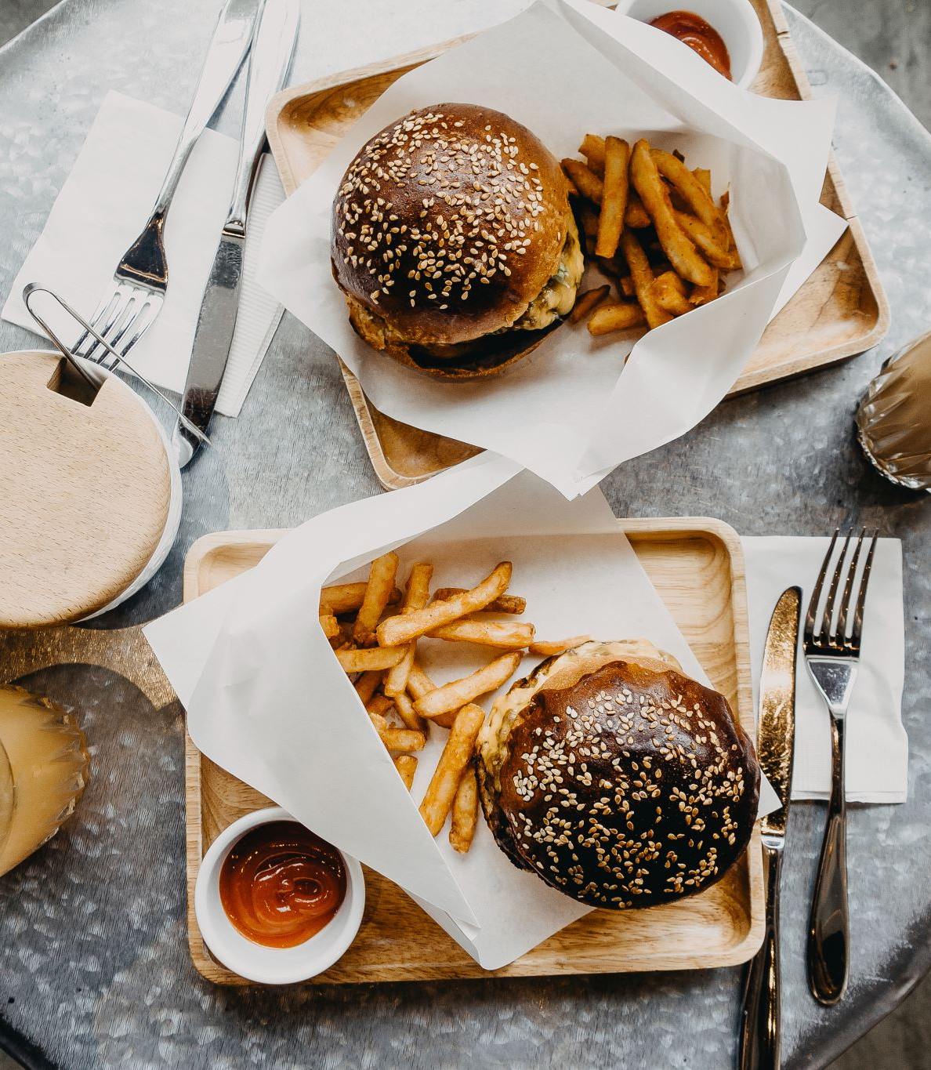
Track What You Eat

Slide 2
Replacing t traceable with 0 in all columns like calories, fat etc. We found out that there are no null values.
Data Preprocessing and cleaning

Slide 3
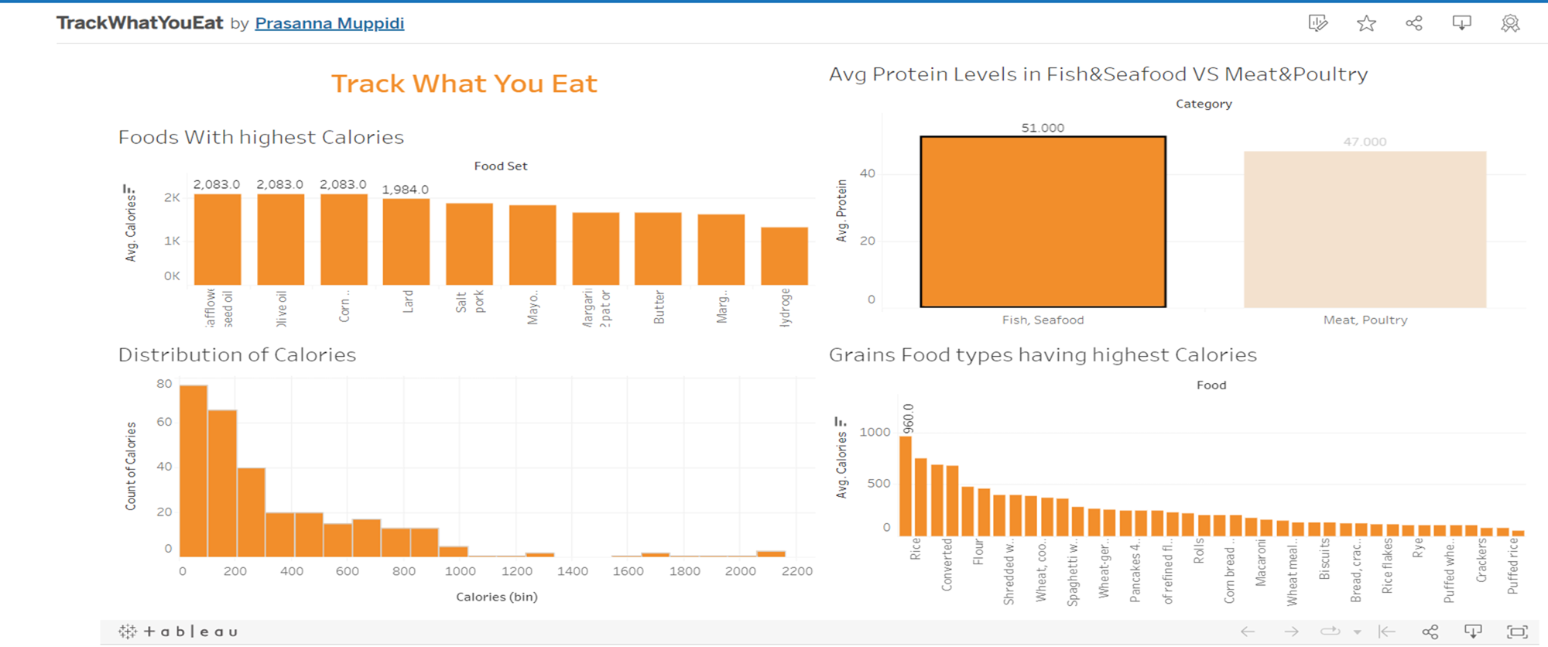
Tableau Dashboard

Slide 4
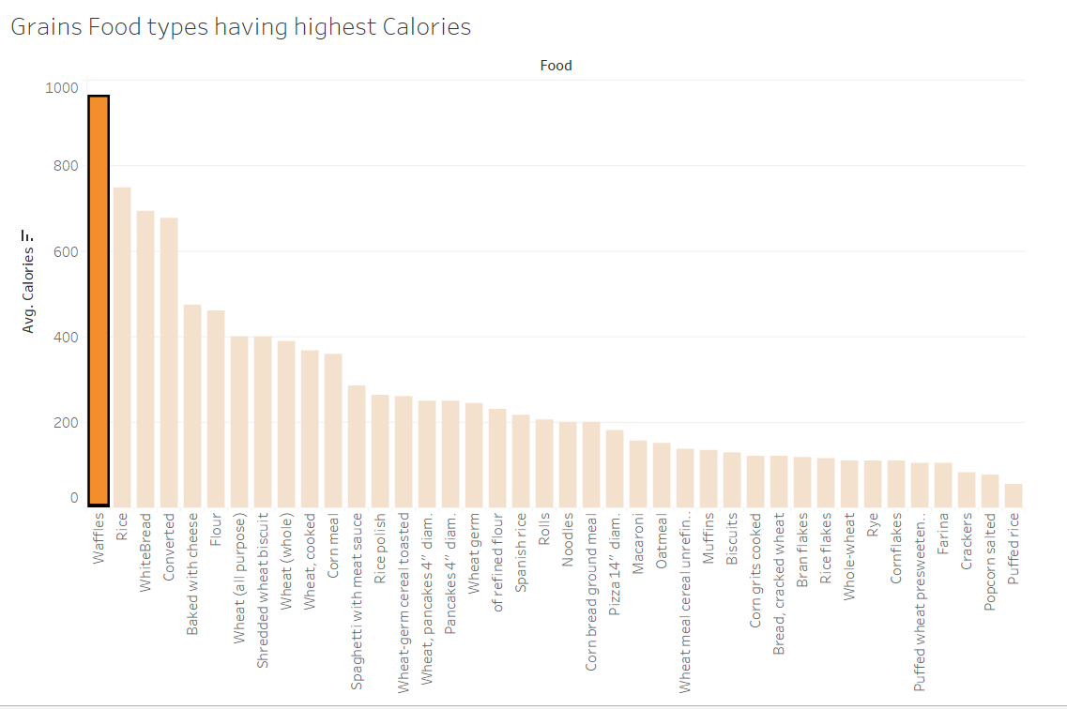
In Grains, Waffles has the highest calories(960 calories)

Slide 5
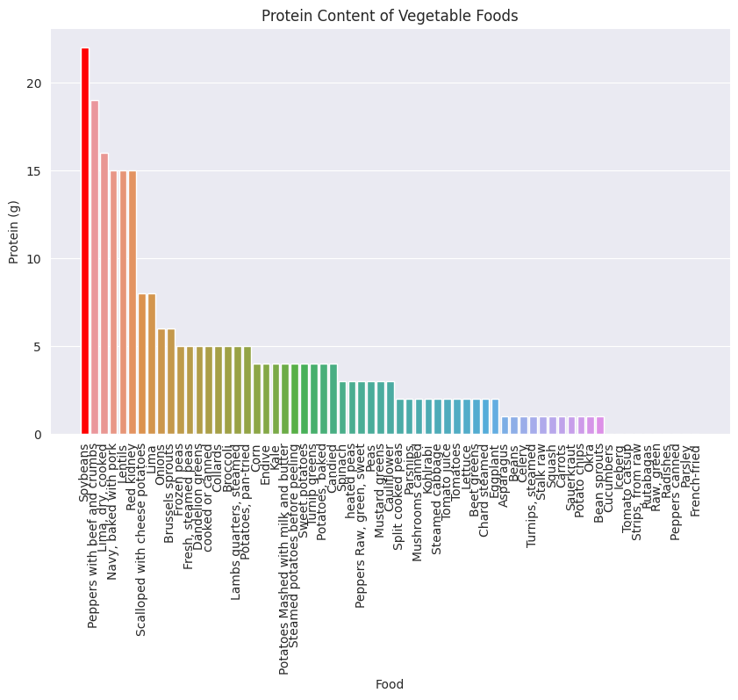
Question3:
In Vegetable Foods, Soybeans has the highest protein content

Slide 6
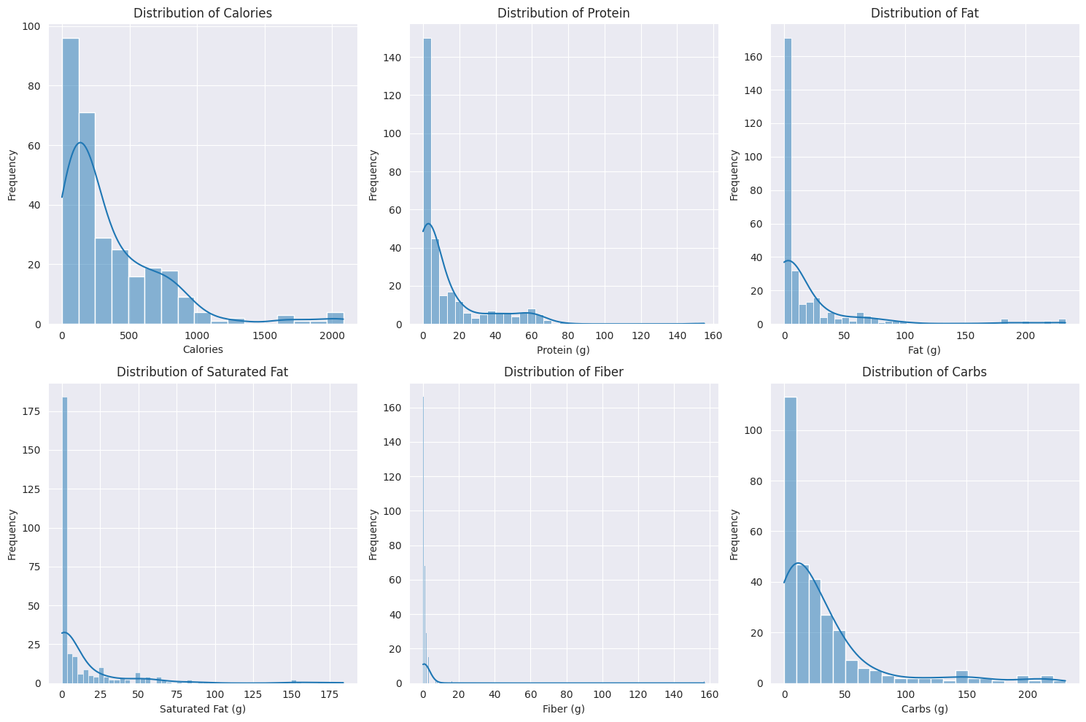
Question 1: Exploratory analysis of the data using visualizations. Your ultimate goal is to start the analysis by plotting the features (Calories, Protein, Fat, Saturated fat, Fiber and Carbs) of each type of food. Generate appropriate graphs to help with the analysis and predictions. A minimum of six graphs are required, with each graph for one dependent variable.

Slide 7
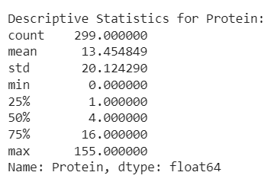
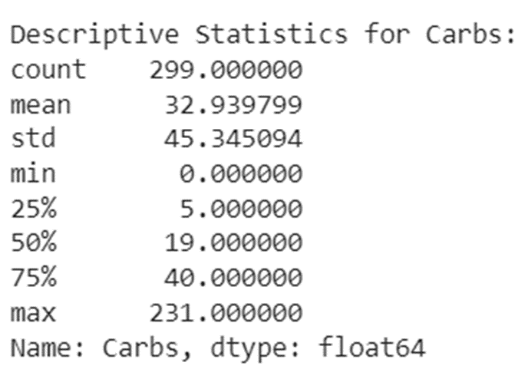
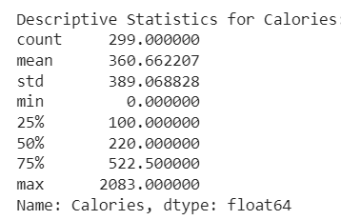
Calories: The dataset's mean caloric intake ranges from 0 to 2083, or roughly 360 calories on average. The overall distribution of calories is slightly tilted to the right, with a greater percentage of lower calorie items, according to the median (50th percentile), which is 220. A great deal of foods fall within the 25th and 75th percentiles, which are between 100 and 522.5, respectively.
Protein: Considering a wide range from 0 to 155 grams, the dataset's mean protein content is roughly 13.45 grams. The distribution of protein is similarly somewhat tilted to the right, with a higher percentage of lower protein foods, according to the median (50th percentile) of 4 grams. Given that the 25th and 75th percentiles of protein content are 1 and 16, respectively, the majority of foods fall within this range.
Carbs: The dataset's mean carbohydrate content ranges from 0 to 231 grams, with a mean of about 32.94 grams. The distribution of carbohydrates is slightly tilted to the right, with a greater proportion of lower carbohydrate items, as indicated by the median (50th percentile) of 19 grams. The average diet contains between 5 and 40 grams of carbohydrates, which corresponds to the 25th and 75th percentiles.

Slide 8
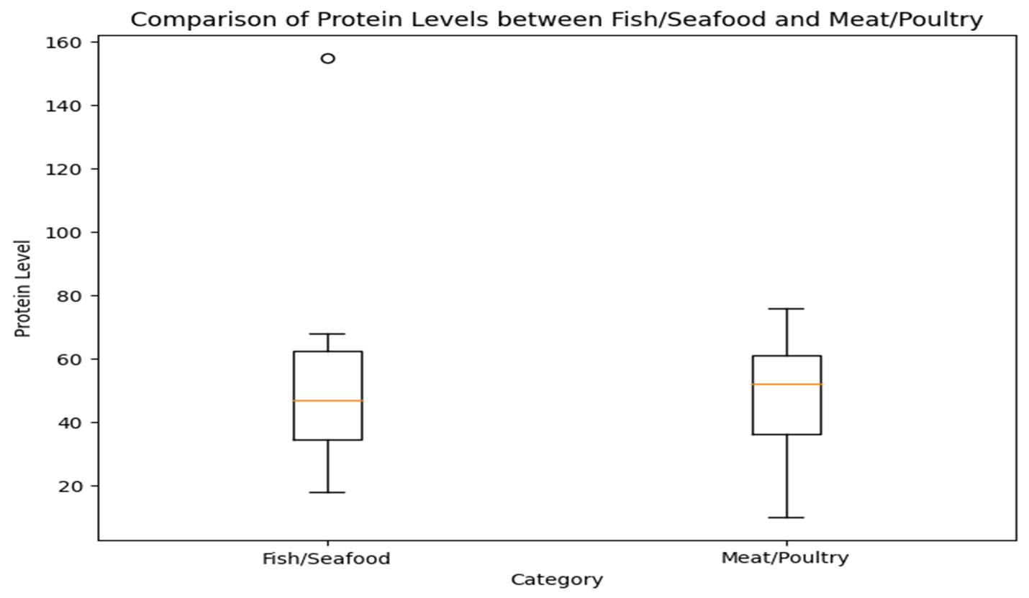
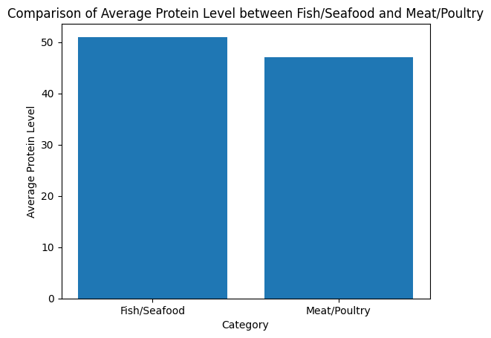
Question2: Your second task is to compare the average protein level between the category of Fish, Seafood and the category of Meat, Poultry. You need to generate appropriate graphs based on your analysis. Provide complete and appropriate analysis to explain if there is a significant difference.
We can see median protein level is more in meat compared to fish and meat is more left skewed whereas fish looks lightly right skewed
Fish/seafood(51) has more avg calories than Meat/Poultry(47)

Slide 9
Are avg protein level in fish, poultry statically same or different
Null Hypothesis: There is no difference in avg protein labels in Fish/SeaFood and Meat?poultry
Alternate Hypothesis:There is difference in avg protein labels in Fish/SeaFood and Meat?poultry
As p is not less than 0.05, we fail to reject null hyphothesis, so we can conclude that there is no statistically significant difference in protein levels between Fish/Seafood and Meat/Poultry categories (p-value >= 0.05)

Slide 10
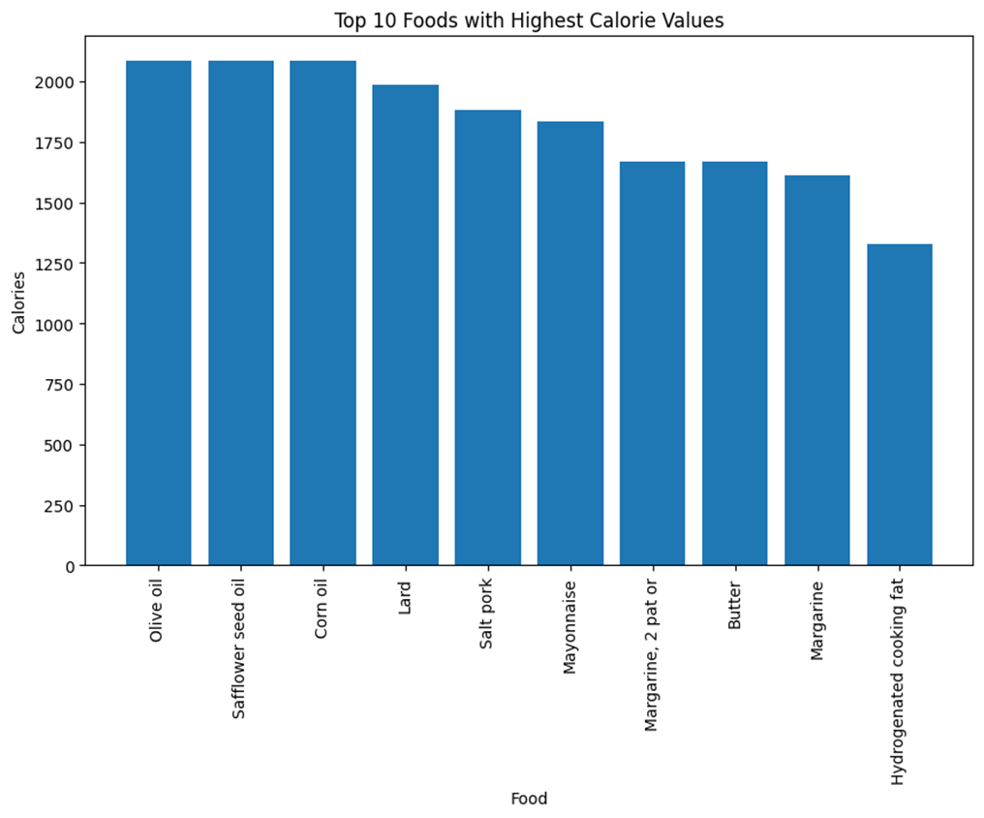
Question3: Your last task is to predict food that has the most calories. You need to generate appropriate graphs as evidence. Provide complete and appropriate analysis and rationale to explain your results.
Here are the top 10 foods with highest Calories: Olive oil, Safflower Seed Oil and corn oil are the top highest calorie foods with almost same calories, Margarine, Butter has almost same calories

Slide 11
Thankyou!

